Slide 1
STOCK PRICE AVERAGE GROWTH FOR A SINGLE YEAR
PRASANNA SAI KURITI
RA1911062010068

Slide 2
AIM AND OBJECTIVE
THE AIM OF THE PROJECT IS TO LET THE USER KNOW WHICH DAY OF THE MONTH IS THE BEST DAY TO INVEST IN STOCKS TO GAIN MAXIMUM PROFIT AND GROWTH IN A PARTICULAR YEAR

Slide 3
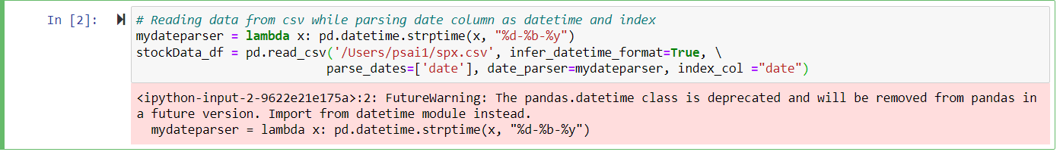
>Reading data from csv while parsing date column as datetime and index >Taking 2017 AS THE YEAR WE WANT TO OBSERVE

Slide 4
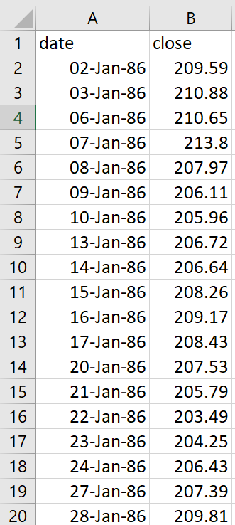
>The given csv file contents

Slide 5
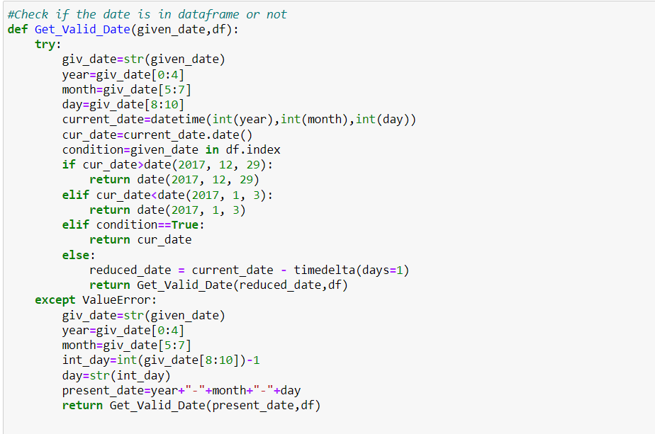
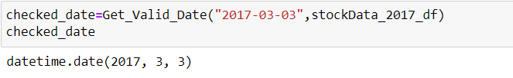
>Check if the date is in the data frame or not

Slide 6
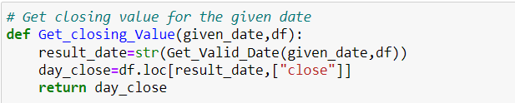

>Get the closing stock price value for the given date

Slide 7
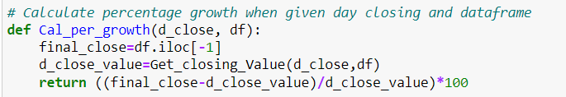

>Calculate percentage growth for the given closing value using the final closing value of the data frame

Slide 8
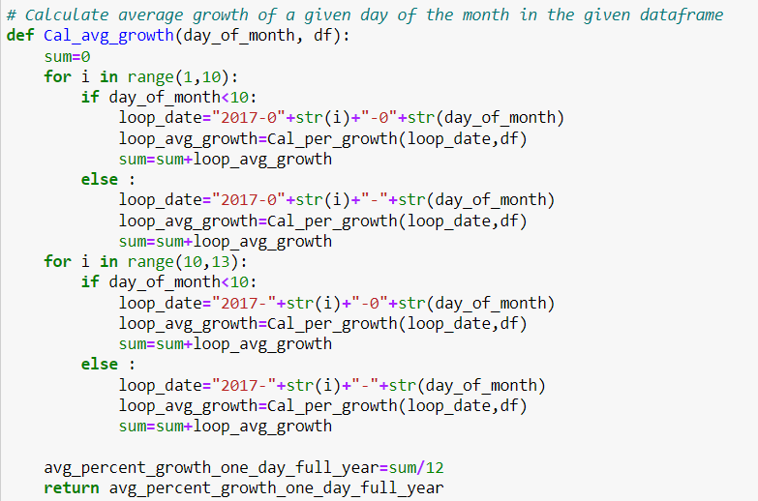

>Calculate average growth of a given day of the month in the data frame

Slide 9
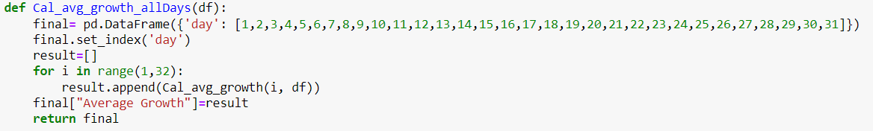
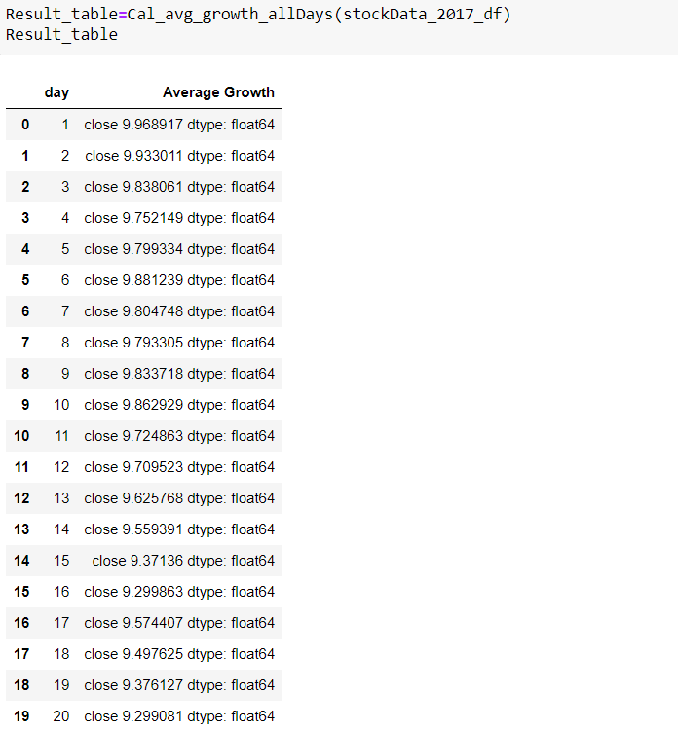
>Calculate average growth for all days in a month

Slide 10
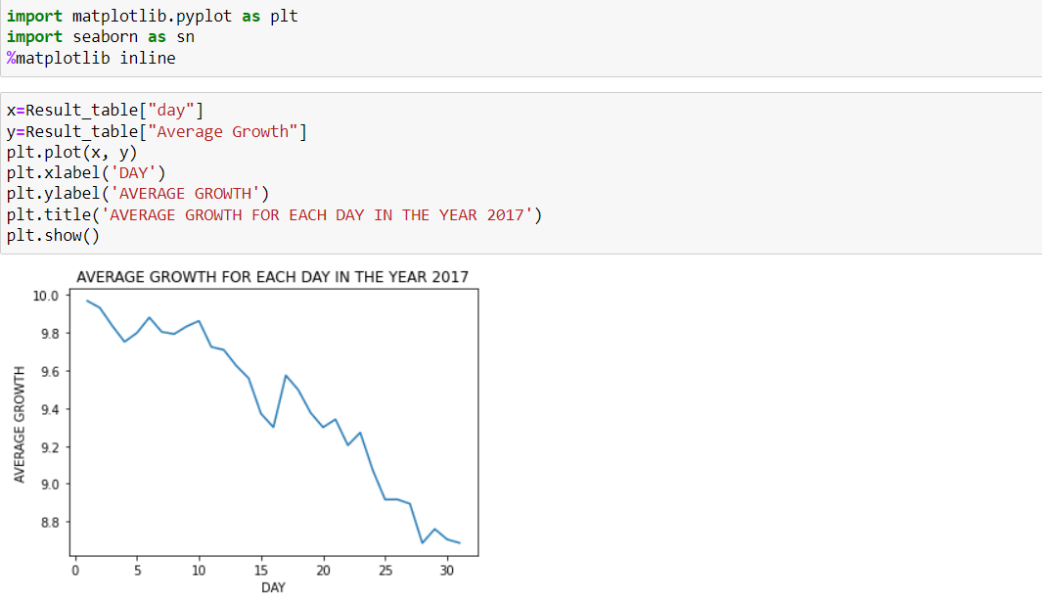
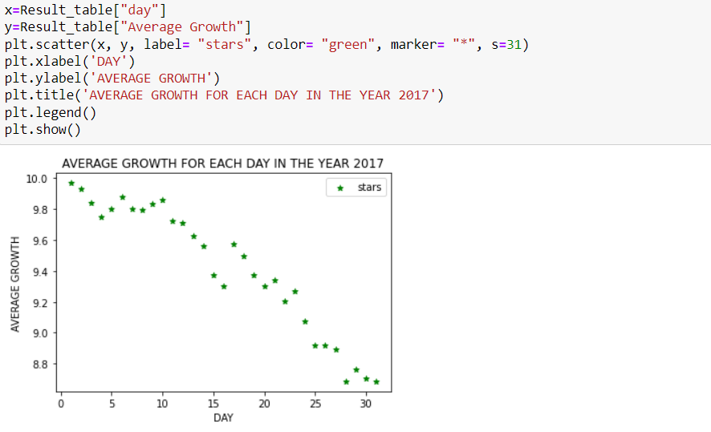
>Graph plotting

Slide 11
THANK YOU!
DROP THE RESULT TABLE IN ANOTHER CSV FILE FOR OSERVATION

